Slide 1


Slide 2

Presentation of the company

Slide 3
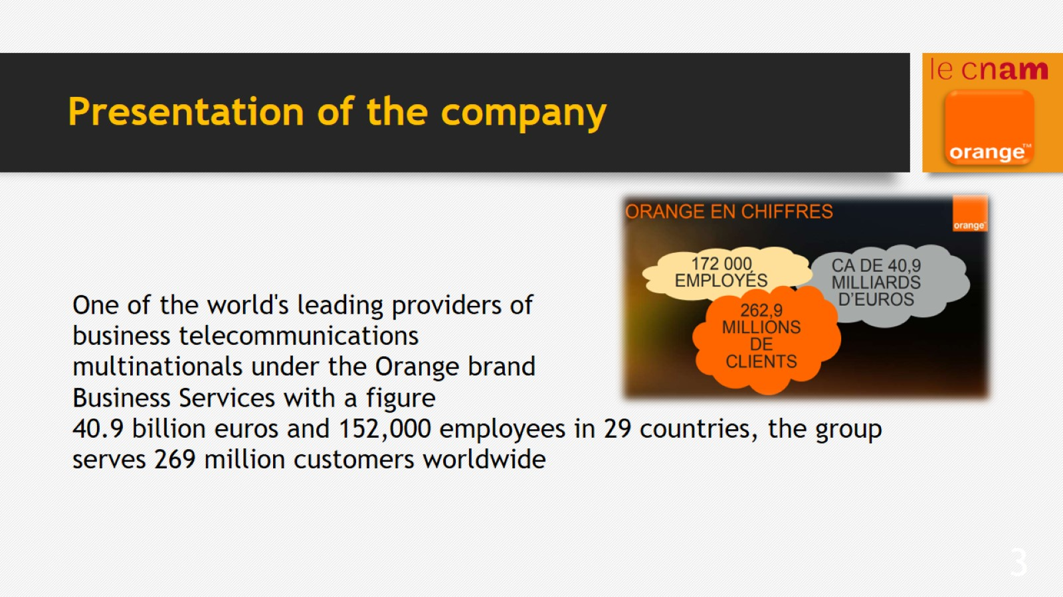
Presentation of the company

Slide 4
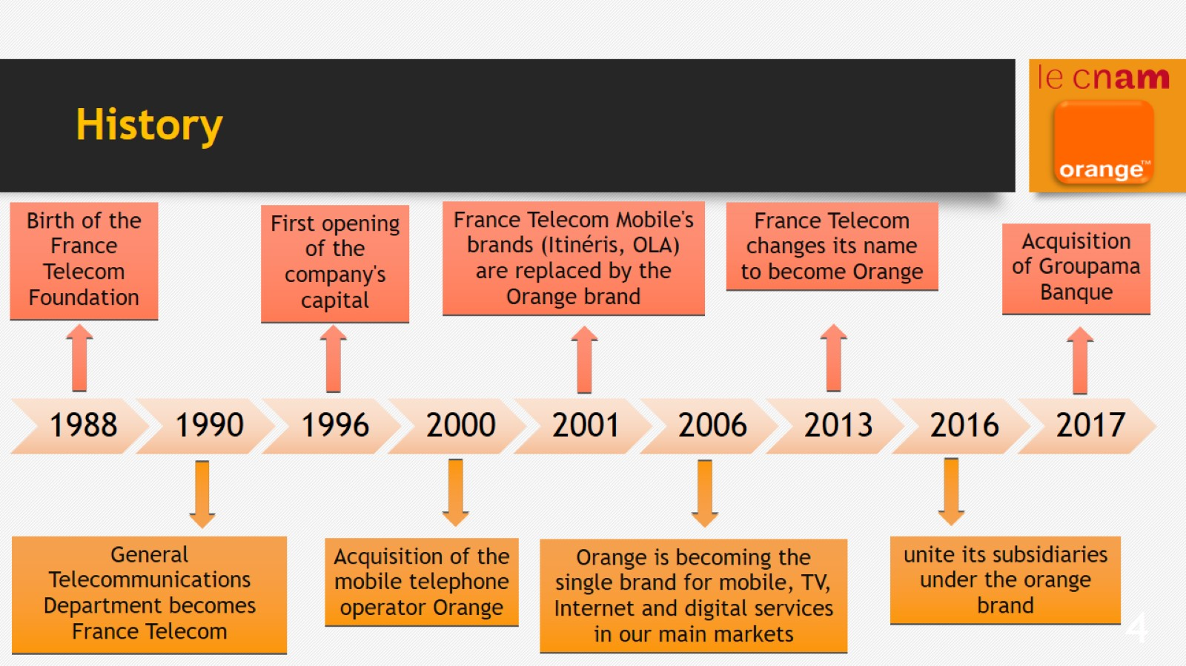
History

Slide 5
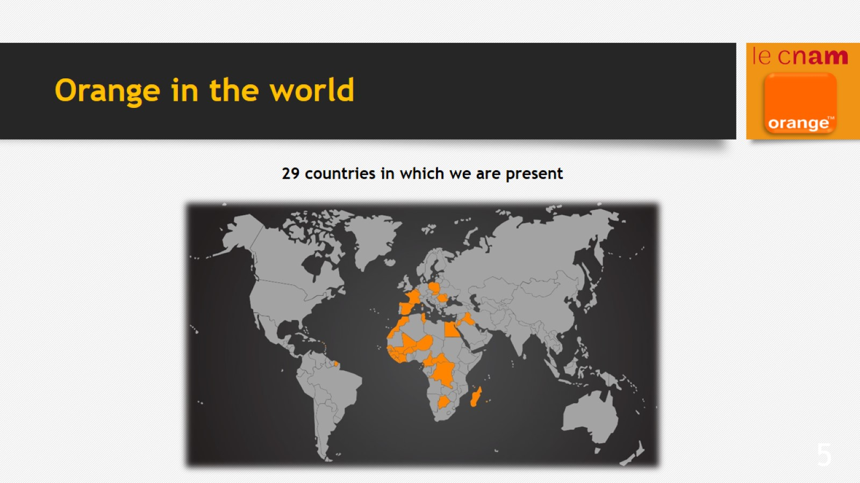
Orange in the world

Slide 6

Orange Wholesale France

Slide 7
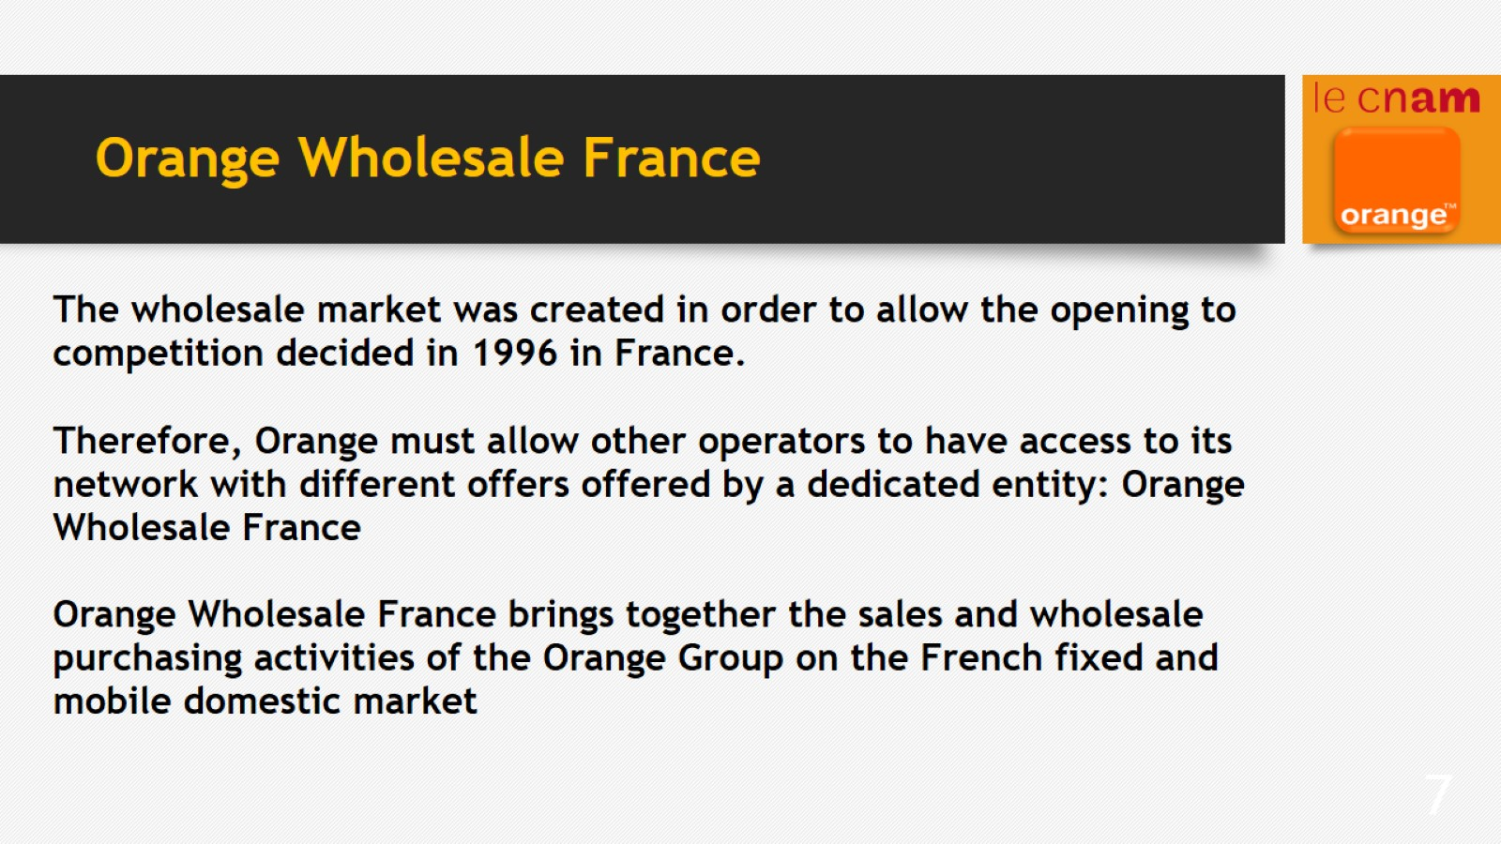
Orange Wholesale France

Slide 8

My work in the company

Slide 9
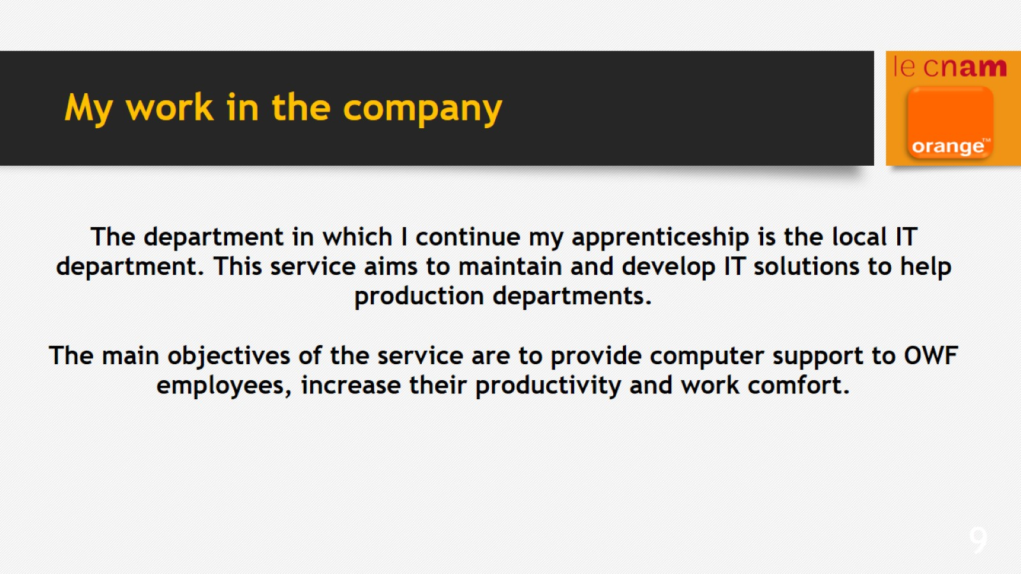
My work in the company

